Slide 1
Object Oriented Programming(Java) Lecture-10

Slide 2
Content
Recursion.
Call by Value & Call by Reference.
Variable-Length Arguments.

Slide 3
Recursion :
Recursion is the process of defining something in terms of itself.
As it relates to Java programming, recursion is the attribute that allows a method to call itself.
A method that calls itself is said to be recursive.

Slide 4
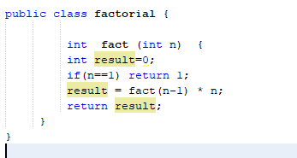
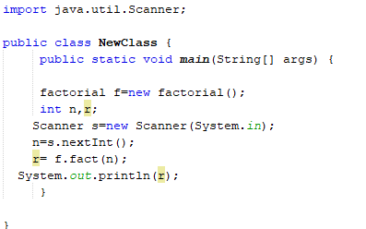
Recursion (Contd.) :

Slide 5
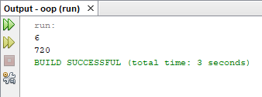
Recursion (Contd.) :

Slide 6
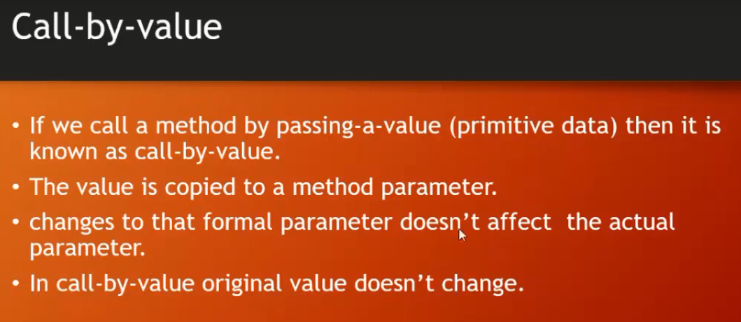

Slide 7
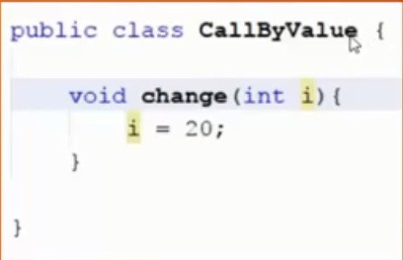
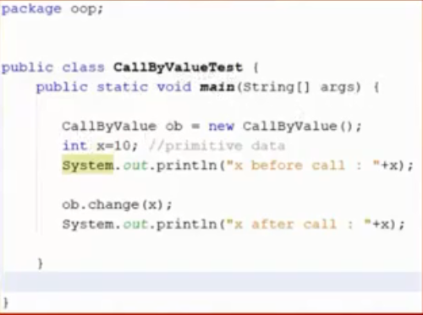
Call-by-value (Contd.) :

Slide 8
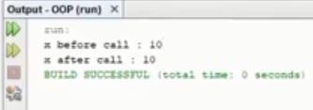
Call-by-value (Contd.) :

Slide 9
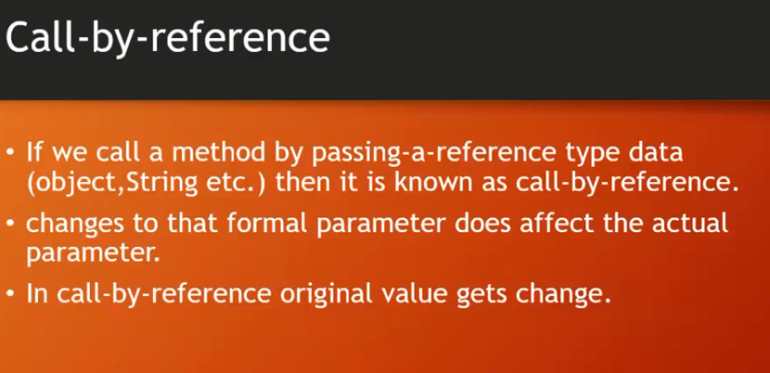

Slide 10
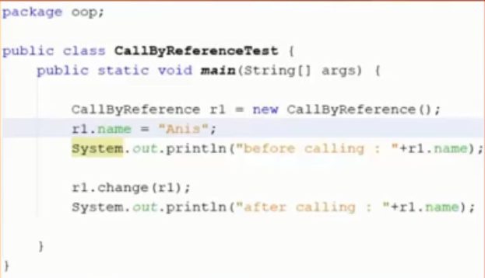
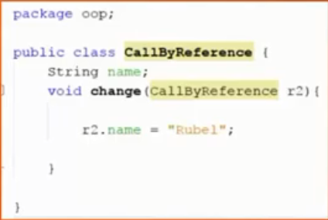
Call-by-reference (Contd.) :

Slide 11
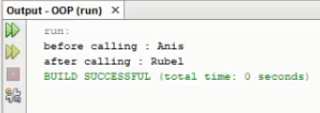
Call-by-reference (Contd.) :

Slide 12
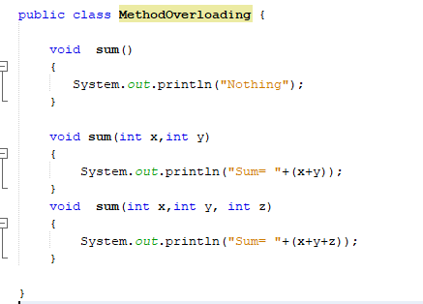
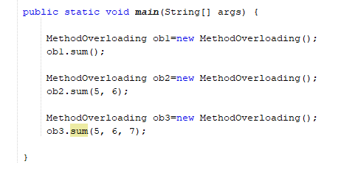
Variable-Length Arguments :

Slide 13
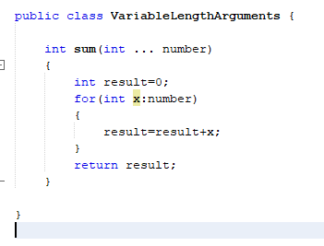
Variable-Length Arguments (Contd.) :

Slide 14
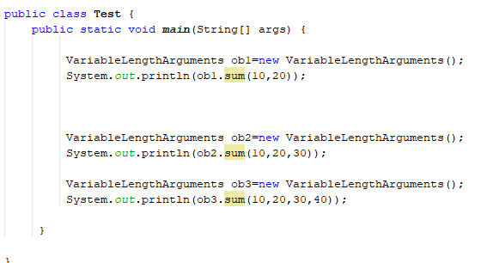
Variable-Length Arguments (Contd.) :

Slide 15
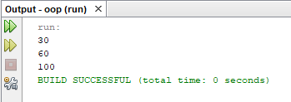
Variable-Length Arguments (Contd.) :

Slide 16
References :
Java-The Complete Reference (7th Edition) by Herbert Schildt (Chapter -7).
http://www.studywithanis.com/

Slide 17
Thanks

